Slide 1

Master Data Management for US Asset
Enterprise Information Architecture
Classification: Confidential
Author Nishit Ajwaliya
Date Sep 2022
Version v0.1
Status DRAFT

Slide 2
01
What is Master Data?

Slide 3
Meta Data, Master Data, Transaction Data
Meta Data
Data about data like structure, meaning, and relationships of data
E.g. Column CUST_ID is a Customer ID and has a size of 10 characters
Reference Data
Codes describing state and behaviour of organization entities and transactions
E.g. Status codes, Reason codes, Type codes, Classification codes, Country, State, Zip/Postal codes
Enterprise Structured Data
Hierarchies within the enterprise
E.g. Organization Hierarchy (Company, Business Unit, Division, Department etc)
Transaction Structure Data
Organization entities in which the transactions act upon
E.g. Customer, Workforce, Asset, Product, Vendor etc
Transaction Activity Data
Operational transactions typically automated in applications
E.g. Customer Billing and Payment, Work Request, Work Order, Worker Learning and Salary/Payment
Transaction Audit Data
Logs of transactions executed to bring about a process flow
E.g. transaction logs of create, update, and view of customer data
Less
More
Meta Data
Meta
Data
Reference Data
Enterprise Structure Data
Transaction Structure Data
Transaction Activity Data
Transaction Audit Data
Volume and Volatility
Semantics
Non transactional, Cross function, Business significant
Master Data Management
Master Data
Transaction Data
More
Less

Slide 4
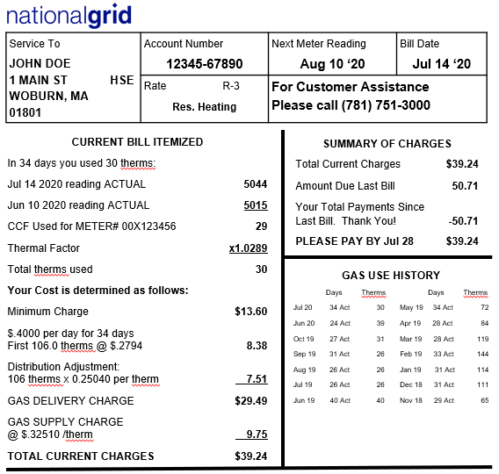
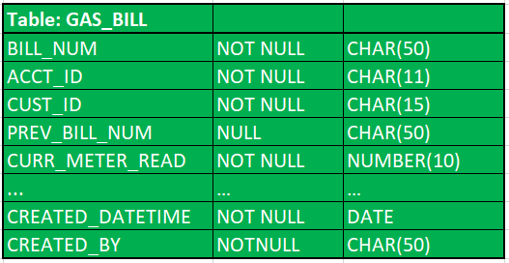
Example: US Customer Gas Bill
Gas Bill Database Table
US Customer actual Gas Bill
Gas Bill Table Data
Legend
Transaction Structure Data
Transaction Activity Data
Reference Data
Transaction Audit Data
Metadata

Slide 5
02
What is Master Data Management?

Slide 6
Reference Data Enterprise Architecture

Slide 7
Master Data Management (MDM)
Master Data Management
(MDM)
Governance
Policies
Processes
Tools
Ownerships
&
Stewardships
Standards
MDM is a set of policies, standards, processes, governance, stewardships, and tools that combined create a commonly trusted, consistent, accurate, and controlled set of “master data” for critical business from across internal and external data sources and applications
With master data management, National Grid will have an authoritative and reliable source of business critical master data that will help better decision making and will support regulatory requirements, Business Analytics and Digital Transformation
Core master data entity includes Customer, Workforce, Asset, Location, Product, Vendor, Reference etc.

Slide 8
Master Data Management High Level Architecture

Slide 9
MDM implementation Style
1. Registry
Build an MDM index with limited key identifier fields and the full data stays in source system
Pros:
Less intrusive as no impact to source systems
Quick and inexpensive to set up
Cons:
Complex to build 360 view if more source systems
Require most MDM configuration
Requires retrieving master data from the source systems
Possible NG use cases:
When only one or two source systems for system of record/truth
Build an MDM centralized repository with curated master data, allow data stewards to correct data in the MDM tool. Cleansed master data is not sync up with source systems
Pros:
Less intrusive as no impact to source systems
Quick and inexpensive to set up
MDM is a repository for Golden master record
Standard MDM Configuration
Cons:
Possible to have data discrepancies between source systems and the MDM tool
Requires manual updates in source systems for data quality issues
Possible NG use cases:
When multiple source systems and they are not able load cleansed data automatically
2. Consolidating

Slide 10
MDM implementation Style
3. Co-Existence
Build an MDM centralized repository with curated master data, allows Data Steward to correct data in the MDM tool, cleansed master data is synced with source systems
Pros:
Cleanse master data are in sync between MDM and source systems
Standard MDM Configuration
Cons:
More intrusive as impacts source systems
Possible NG use cases:
When multiple source systems and systems can load/take cleansed data automatically
No source system so MDM tool is the source of record
Pros:
MDM is the system of truth and source system
Cons:
Most intrusive as MDM becomes source system
Most MDM configuration
Possible NG use cases:
When there is no source systems e.g. Reference data like Postal data
4. Transaction/Centralized

Slide 11


